Slide 1


English 1
3rd Quarter
Week 4
April 18, 2023

Slide 2

READ THE WORDS
Drill
bed
fed
red
keg
leg
peg
den
hen
men

Slide 3
READ THE WORDS
pen
get
Jet
let
net
vet
wet
yet
web
help
tell

Slide 4
SIGHT WORDS
a
and
are
as
at
be
for
from
had
have
he
his

Slide 5
SIGHT WORDS
I
in
is
it
of
on
that
the
they
this
to
was

Slide 6
SIGHT WORDS
we
with
you
an
by
but
can
do
had
not
one
said

Slide 7
SIGHT WORDS
when
which
who
Will
your
she
so
up
what

Slide 8
SIGHT WORDS
when
which
who
Will
your
she
so
up
what

Slide 9
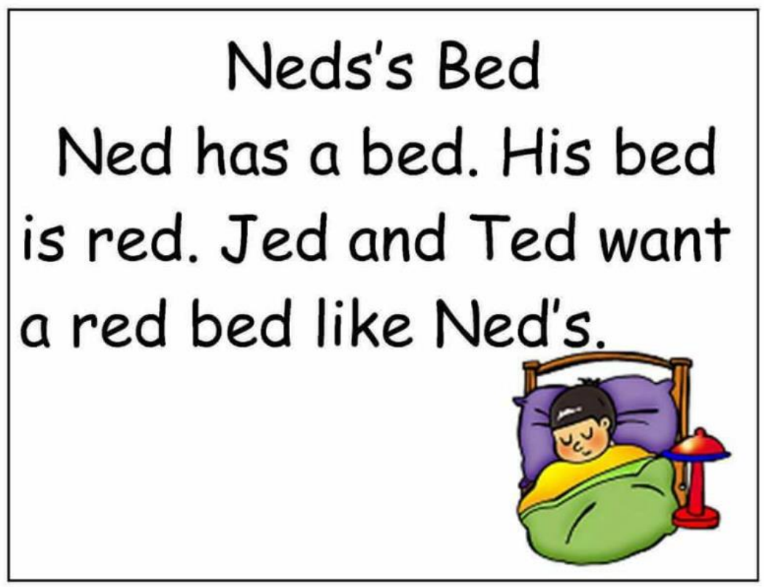
Read

Slide 10
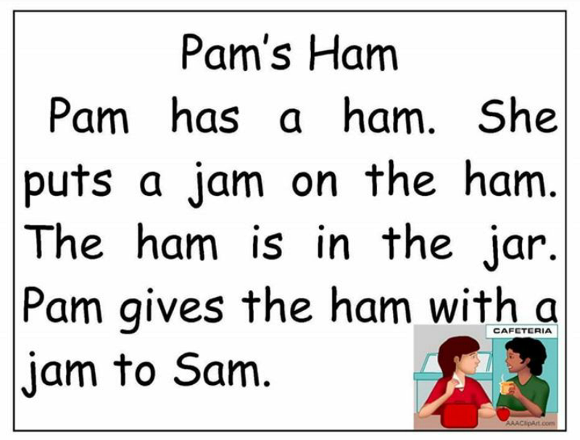
Read

Slide 11
Review
Direction: Choose the letter of the correct answer.
What is an exclamatory sentence?
a. A sentence that expresses strong feelings or emotions
b. A sentence that gives a command
c. A sentence that asks a question

Slide 12
2. Which punctuation mark is used at the end of an exclamatory sentence?
a. Period (.)
b. Comma (,)
c. Exclamation mark (!)

Slide 13
3. Which of the following sentences is an example of an exclamatory sentence?
a. I have a blue backpack.
b. Yay, we won the game!
c. Please pass the salt.

Slide 14
4. What do exclamatory sentences express?
a. Questions
b. Commands
c. Strong feelings or emotions

Slide 15
5. Which of the following sentences is an example of an exclamatory sentence?
a. Awesome, that's my favorite song!
b. Can I have a cookie, please?
c. I like pizza.

Slide 16
Listen to short stories/poems. Note important details pertaining to:
a. Character
b. Setting
c. Events

Slide 17
Do you still know the song “Twinkle, Twinkle Little Star”? Can you sing it? Let us sing this song together.

Slide 18


Slide 19
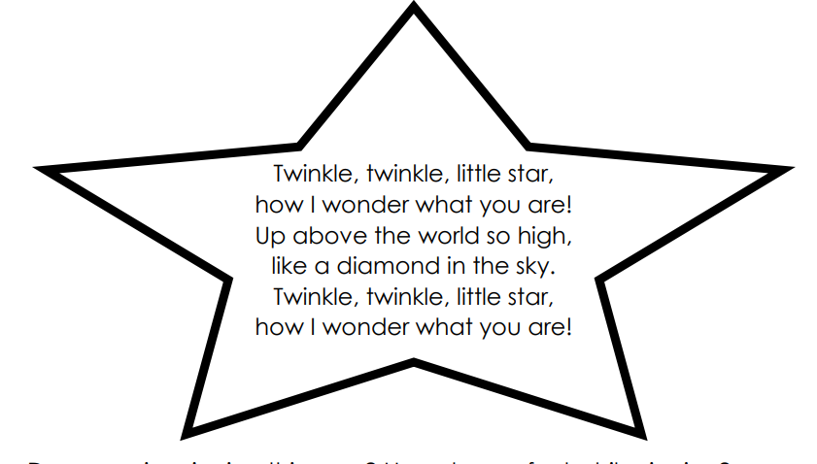

Slide 20
Activity 1. Shine Bright Like a Star!
How well do you understand the song? Say the letter of the correct answer.
1. What is the song about?
A. sky B. star C. snow D. sea

Slide 21
2. Where can you see the stars?
A. in the sky
B. in the sea
C. in the mountain
D. in the forest

Slide 22
3. What does a star look like?
A. like a stone
B. like a kite
C. like a diamond
D. like a firework

Slide 23
4. When can we see a star?
A. in the morning
B. in the afternoon
C. in the evening
D. in the dark

Slide 24
5. What does the child think about the stars?
A. “How I wonder where you are?”
B. “How I wonder what you do?”
C. “How I wonder where you come from?”
D. “How I wonder what you are?”

Slide 25
Let’s Watch the short story of
“The Little Red Hen”
https://www.youtube.com/watch?v=-M9aut3WVW8
Or you can read
Here on the slide

Slide 26


Slide 27
The Little Red Hen
Once upon a time, there was a Little Red Hen who lived on a farm with her animal friends - a cat, a Duck, and a dog. One day, the Little Red Hen found some wheat seeds and asked her animal friends if they would help her plant them.
"Who will help me plant the wheat?" asked the Little Red Hen.
"Not I," said the dog. "Not I," said the Duck. "Not I," said the cat.

Slide 28
So the Little Red Hen planted the wheat seeds all by herself. She took care of the wheat plants until they grew tall and golden. Then she asked her animal friends if they would help her harvest the wheat.
"Who will help me harvest the wheat?" asked the Little Red Hen.
"Not I," said the dog. "Not I," said the Duck. "Not I," said the Cat.

Slide 29
So the Little Red Hen harvested the wheat all by herself. She took the wheat to the mill to be ground into flour. Then she asked her animal friends if they would help her bake the flour into bread.
"Who will help me bake the bread?" asked the Little Red Hen.
"Not I," said the dog. "Not I," said the Duck. "Not I," said the Cat.

Slide 30
So the Little Red Hen baked the bread all by herself. When the bread was fresh and hot out of the oven, the Little Red Hen asked her animal friends if they would like to share it with her.
"Who will help me eat the bread?" asked the Little Red Hen.
"We will!" said the dog, the Duck, and the Cat.

Slide 31
But the Little Red Hen replied, "No, I will eat the bread all by myself, since I did all the work."
And so the Little Red Hen enjoyed the delicious bread all by herself, while her lazy animal friends watched and learned a lesson about the value of hard work.

Slide 32
In reading a short story, you can note the details by knowing the following elements of the story:
Character
Setting
Events

Slide 33
Character: The character is a person, animal, or thing that takes part in the story.
In the story “The Little Red Hen”
Who are the character of the story?

Slide 34
Setting: The setting is the time and place where the story takes place. It includes the physical environment, such as the location, weather, and landscape.
In the story “The Little Red Hen”
Where did the story happened?

Slide 35
3. Events: Events are the things that happen in a story. -They can include actions, dialogue, and descriptions that move the story's plot forward.
-The events can be organized into rising action, climax, falling action, and resolution.
-The events can also include conflicts and obstacles that the characters must overcome in order to achieve their goals.
In the story “The Little Red Hen”
What are the events happened in the story?

Slide 36
Evaluation
1. Who is the main character in the story?
a. The Little Red Hen
b. The cat
c. the dog

Slide 37
2. Where does the story take place?
a. In a city
b. In a jungle
c. On a farm

Slide 38
3. What did the Little Red Hen ask her animal friends to help her with?
a. Planting the wheat seeds
b. Watering the wheat plants c. Harvesting the wheat

Slide 39
4. Did the animal friends agree to help the Little Red Hen?
Yes, they all agreed to help her.
b. No, they refused to help her. c. Some agreed and some refused

Slide 40
5. Who ended up eating the freshly baked bread?
a. The Little Red Hen and her animal friends
b. The Little Red Hen and her family
c. The Little Red Hen alone

Slide 41
Evaluation
1. Who is the main character in the story?
a. The Little Red Hen
b. The cat
c. the dog

Slide 42
2. Where does the story take place?
a. In a city
b. In a jungle
c. On a farm

Slide 43
3. What did the Little Red Hen ask her animal friends to help her with?
a. Planting the wheat seeds
b. Watering the wheat plants c. Harvesting the wheat

Slide 44
4. Did the animal friends agree to help the Little Red Hen?
Yes, they all agreed to help her.
b. No, they refused to help her. c. Some agreed and some refused

Slide 45
5. Who ended up eating the freshly baked bread?
a. The Little Red Hen and her animal friends
b. The Little Red Hen and her family
c. The Little Red Hen alone

